Slide 1
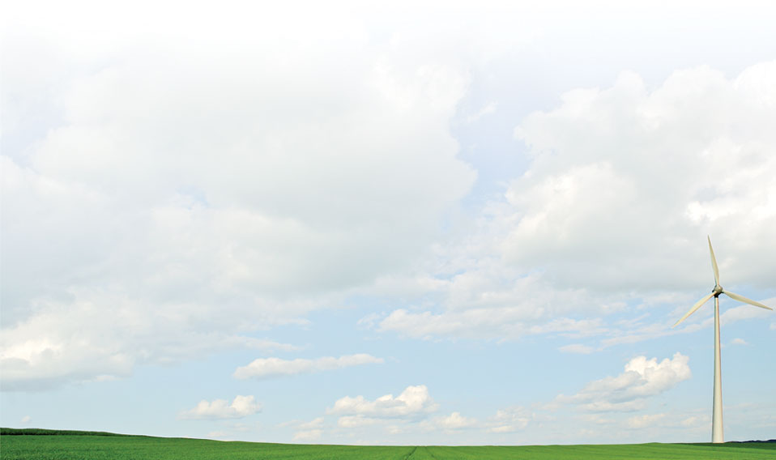
The Grid
This section provides you a preliminary background of the grid and the future of the grid.

Slide 2
Current Energy Problems
Fluctuating demand and supply
Overlapping energy markets
Business Operations
End-use appliance technologies, equipment, and controls
Notes:
Consumer behavior including daily, weekly, and seasonal demand profiles, price response, and contract choice.
Overlapping energy markets.
Energy operations, such as distribution automation, load-shedding programs, and emergency operations.
Business operations, such as retail rate, billing, and market-based incentive programs.
End-use appliance technologies, equipment, and controls.

Slide 3
Grid
Electricity Grid
  Multiple networks
  Multiple power generation companies
  Multiple power operators
  Manually controlled communication and coordination
Moves electricity in bulk in one direction
  To consumers and business
Notes:
Voltages and capacitors are automated but moving power through the system is manually operated.

Slide 4
Smart Grid
Paradigm shift
  Bi-directional
  Load intelligence
  Need to modernize the transmission and distribution grids
Smart grid delivers electricity from suppliers to consumers using digital technology
  Save energy
  Reduce cost
  Increase reliability and transparency
  Energy independence
  Global warming
Notes:
This paradigm is changing as businesses and homes begin generating more wind and solar electricity, enabling them to sell surplus energy back to their utilities. Modernization is necessary for energy consumption efficiency, real time management of power flows and to provide the bi-directional metering needed to compensate local producers of power. Although transmission networks are already controlled in real time, many in the US and European countries are antiquated by world standards, and unable to handle modern challenges such as those posed by the intermittent nature of alternative electricity generation, or continental scale bulk energy transmission. (wikipedia)
Turn off excess machinery to balance load.
Communication between consumers to utilities
price-demand
if power is too expensive then they can shift load

Slide 5
The Flow of Energy
Source
Nuclear
Electricity
(38 Quads)
Coal
Losses
(25.5 Quads)
Commercial
Renewable
Coal
Residential
Natural Gas
Renewable
Natural Gas
Industrial
Use
Petroleum
Petroleum
Transportation
Source: DOE/LLNL (2007) – energy in quadrillion BTU *quads)

Slide 6
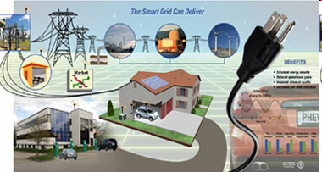
Goal of New Technology
Construction of 21st century electrical system that connects everyone
  Affordable
  Clean
  Efficient
  Reliable
Notes:
http://www.oe.energy.gov/smartgrid.htm

Slide 7
A need for a tool
Ability to study distribution utility system behavior over periods of time.
  Provides reliability metrics
  Provides business metrics such as profitability, revenue rates of return
  Provides per customer or per line-mile cost metrics.
Notes:
Need to address all the problems stated in the previous slide.

Slide 8
Why Simulate the Smart Grid?
Evaluate the potential of new technologies and operational strategies to save capital costs, improve reliability, provide other benefits
Craft and refine the characteristics of technologies and operational strategies for maximum benefit at lowest cost
Understand and quantify synergies of deploying a broad range of smart grid technologies
Avoid unintended consequences that can result from utilizing distributed control systems
Predict and evaluate results from deployment projects
Extrapolate regional/national impacts

Slide 9
What is GridLAB-D?
Simulation Environment
  Build studies and analyze results
  Uses modeling tools that allows users to create detailed models
Works with third party data management and analysis tools.
  Works with independent devices.
Tools to create and validate structures
  Examine consumer reaction, verify the reaction
Notes:
Example is needed to elaborate this slide. A demo may be useful.

Slide 10
Unique Capabilities
Detailed time-series simulation
  New devices/strategies/behaviors/interactions
  System growth, capacity expansion, etc.
  Multiple time-scales (seconds to decades)
Simultaneous solution at all levels
Track costs and benefits in scenarios
Extrapolate impacts at higher levels
Open model architecture

Slide 11
Example Simulation
Prototypical feeder representing what is seen in cold climate regions of the Continental United States
This feeder was populated with primarily residential loads
90% overhead lines & 10% underground lines
1031 primary nodes, 125 center-tap transformers, and 1347 single family homes, with associated triplex lines
Substation has independent regulators for each phase that regulate the voltage at a remote node

Slide 12
Feeder Simulation
Simulation was run for 24 hours with a minimum 1 minute time steps (total of 1440 time steps for a single day)
Run with weather data from January 2000 – High was 30°F, Low was 14°F
3 cases were examined
  Regulated at 124V gas heated houses
  Regulated at 120V gas heated houses
  Regulated at 116V gas heated houses

Slide 13
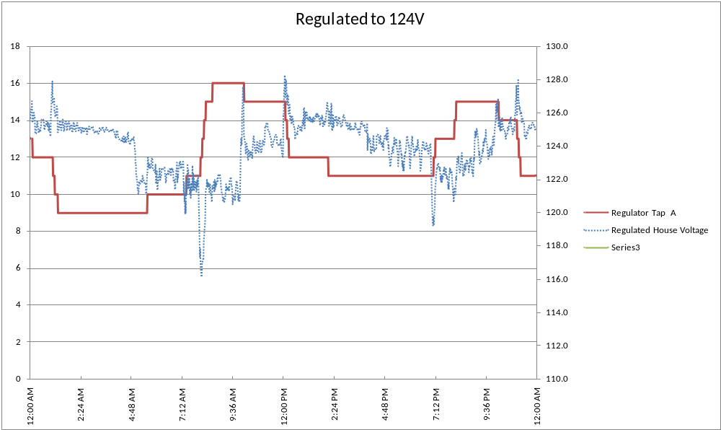
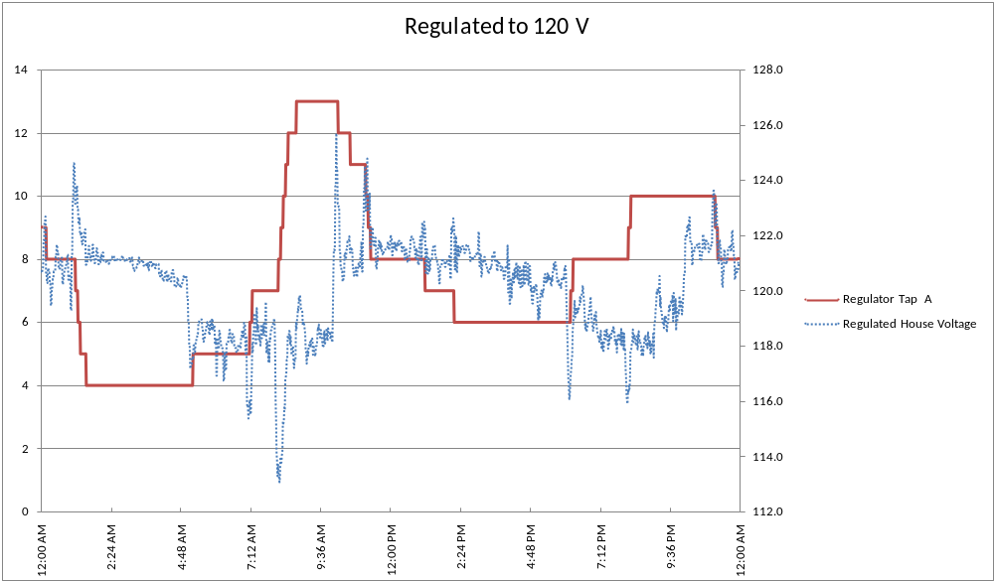
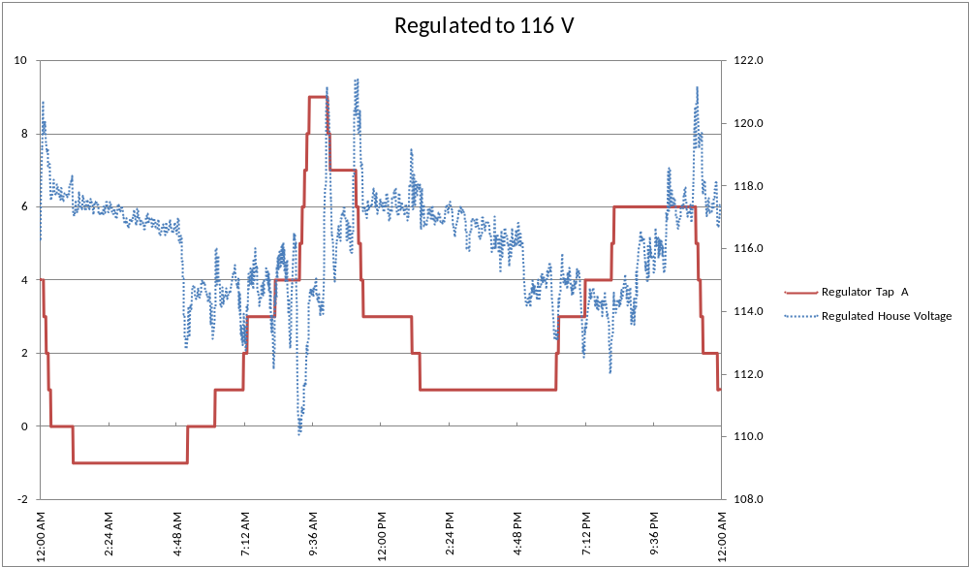
Feeder Simulation

Slide 14
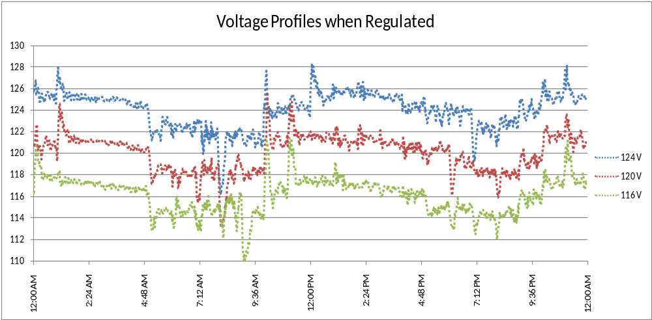
Feeder Simulation

Slide 15
Simulation Result Losses
 | Measured Energy at Substation (kW-hr) | Measured Energy at Center Tap Transformers (kW-hr) | Measured Energy at Houses (kW-hr) | Losses on System (kW-hr) | Losses on Center Tap Transformers (kW-hr)
124 V | 68,639 | 65,698 | 65,293 | 3,346 | 405
120 V | 67,142 | 64,205 | 63,801 | 3,341 | 404
116 V | 63,949 | 61,104 | 60,714 | 3,236 | 391
6.83 % Reduction
7.01 % Reduction
3.29 % Reduction

Slide 16
Simulation Results
CVR Factors
 | 124V - 116V | 124V - 120V
System | 1.06 | 0.68
House | 1.09 | 0.71
Transformer | 1.08 | 0.70
Differences are due to complex load models

Slide 17
Remarks
Complex models allow for a more detailed understanding of system behaviors
New systems will increase the complexity and potentially lead to emergent behaviors that must be understood
Understanding of these behaviors will help to determine which of the emerging technologies should be pursued
While the previous example focused on CVR many other technologies will require this level of analysis

